Slide 1
Ocean Acidification
Carbon Dioxide and our Oceans

Slide 2
What is Ocean Acidification and how does it affect the me?
http://youtu.be/aG3n1fAa7vk “Acid Test” 3 Minute intro video clip
OR
The Natural Resources Defense Council (NRDC) documentary explores ocean acidification, which is challenging marine life on a path not seen for tens of millions of years. The film, featuring Sigourney Weaver, originally aired on Discovery Planet Green.
http://youtu.be/5cqCvcX7buo “Acid Test” 21 min Sigourney Weaver video

Slide 3
VOCABULARY
Ocean acidification
Exoskeleton
Endoskeleton
Coral reef
pH
Carbon dioxide
Calcium Carbonate
Carbonic Acid
CO₂ emissions
Carbon sink

Slide 4
Background information
Calcium carbonate (CaCO₃) is a mineral
Hardness and strength to seashells, rocks, coral reefs, eggshells
Found in rivers and oceans
Marine organisms’ endoskeleton and exoskeleton are made of Calcium carbonate (CaCO₃)
Hard substance giving organisms protection
Shell-forming organisms include corals, oysters, shrimp, lobster
Readily reacts with acid yielding carbon dioxide gas, water, and calcium chloride:
CaCO₃ + 2HCl → CO₂ + H₂O + CaCl₂

Slide 5
What is Ocean Acidification?
http://www.pmel.noaa.gov/co2/story/What+is+Ocean+Acidification%3F

Slide 6
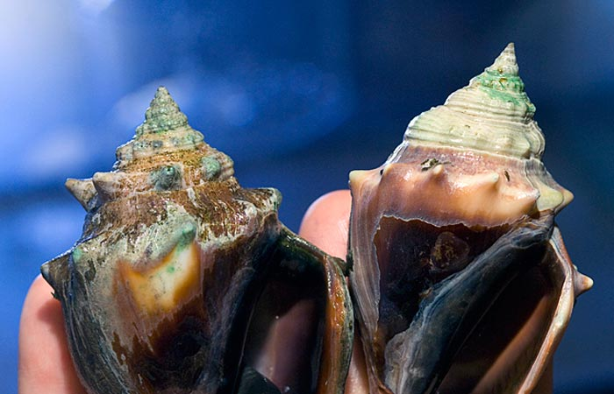
pH and ocean organisms
If the ocean becomes more acidic, marine organisms’ endoskeleton and exoskeleton become softer, relinquishing protection and structure.

Slide 7
What is pH?
pH scale runs from 0-14
For millions of years our oceans have maintained slightly basic average pH 8.2
It has decreased to pH 8.0 as reported by NASA data (www.oceancolor.gsfc.nasa.gov)
25% increase in acidity in the past two centuries

Slide 8
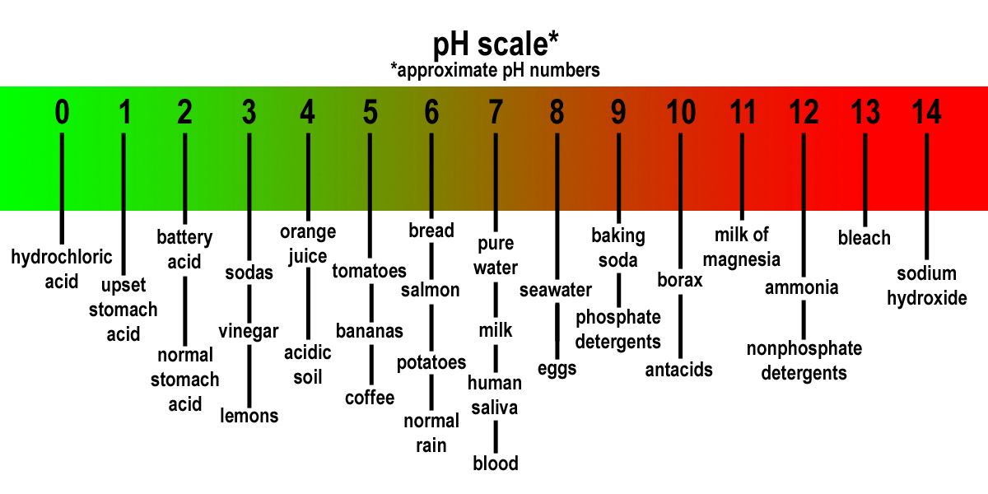
Where is ocean water on the pH scale?

Slide 9
http://www.pmel.noaa.gov/co2/OA/background.html

Slide 10
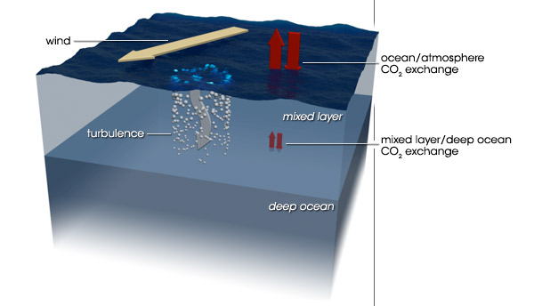
Our oceans become more acidic
Oceans continue to absorb more CO₂
Capacity as a “carbon sink” could diminish
More of the CO₂ emitted will remain in the atmosphere, further aggravating global climate change
http://earthobservatory.nasa.gov/Features/OceanCarbon/

Slide 11
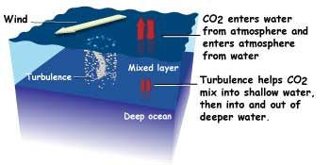
How does it work?
Scientific awareness is relatively recent, 2003
Indicators show humans are able to control and eventually eliminate our fossil fuel emissions
Ocean organisms will adapt to their habitat's changing chemistry or perish

Slide 12
NASA resources Reinforce and Enrich student knowledge of CO2 and Ocean Acidification
http://disc.sci.gsfc.nasa.gov/OCO-2 NASA data with new carbon dioxide readings
http://www.nasa.gov/topics/earth/features/climate_acidocean_prt.htm
NASA article to print and students will read. Can use as a Jigsaw or Carousel reading by numbering and assigning paragraphs to groups. Each group will read and summarize their assigned paragraph and share with the class.
http://i2i.stanford.edu/AcidOcean/AcidOcean.htm Acidifying Ocean virtual lab
http://visibleearth.nasa.gov/view.php?id=84655 Counting Carbon in Southern California
http://www.nasa.gov/mission_pages/oco2/index.html
Latest news of OCO-2 and monitoring data showing levels of carbon dioxide recorded.
http://oco2.jpl.nasa.gov/ The latest data of the OCO-2 satellite will be released to the public on 30 December, 2014

Slide 13
Launching of NASA OCO-2 to record and indicate carbon dioxide
https://www.youtube.com/watch?v=njf67aov4XA&index=4&list=PLiuUQ9asub3SOdRC7ZHR8ocKHUcjlwtGW
The video clip shows the lift off of the OCO-2 which will monitor Carbon dioxide levels in the atmosphere. This data will reinforce the cause and effect of human impact and burning fossil fuels
The Delta II rocket lifts off from Space Launch Complex 2 at Vandenberg Air Force Base carrying the Orbiting Carbon Observatory, or OCO-2, satellite on a on a mission to study the Earth's atmosphere.
Liftoff was at 2:56 a.m. PDT 2 July, 2014

